Slide 1
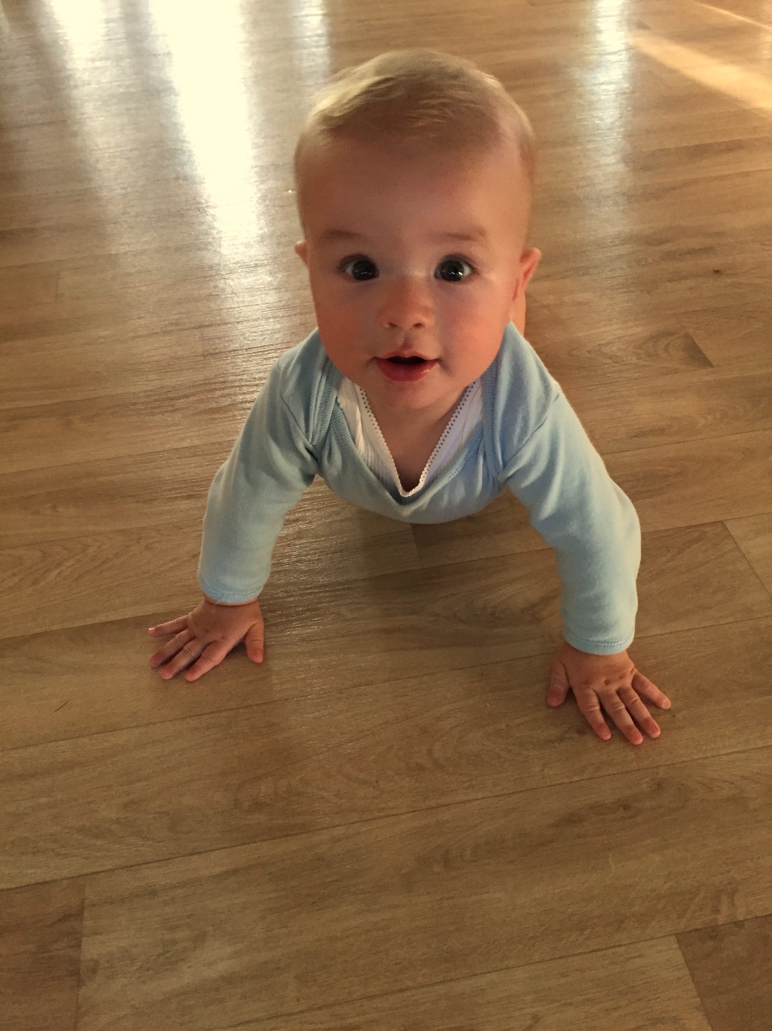
Miracles
Chris Jaensch

Slide 2
Some people say
that miracles are rare,
as hard to catch as whispers in the air,
as hard to see as stardust in the sky,
elusive as a winter butterfly.

Slide 3
But as we see this child
before us now
we know a miracle has come.
We see this wonder and delight
at this new life now begun.

Slide 4
Praise the Lord,
yes it’s time to give Him praise.
Praise the Lord
for this miracle He’s made.
For this special gift of love
sent down from above
praise the Lord.

Slide 5
As we stand together here today
another miracle has come our way.
Through Water and the Word,
God’s mystery,
this child has moved into eternity.

Slide 6
As we see this child
before us now
we know a miracle has come.
We see this wonder and delight
at this new life now begun.

Slide 7
Praise the Lord,
yes it’s time to give Him praise.
Praise the Lord
for this miracle He’s made.
For this special gift of love
sent down from above
praise the Lord.

Slide 8
And may this family every day behold
as constantly fresh miracles unfold:
a baby’s cry
or happy chuckling smile,
first words, first steps,
a growing healthy child.

Slide 9
As we see this child
before us now
we know a miracle has come.
We see this wonder and delight
at this new life now begun.

Slide 10
Praise the Lord,
yes it’s time to give Him praise.
Praise the Lord
for this miracle He’s made.
For this special gift of love
sent down from above
praise the Lord.

